Slide 1
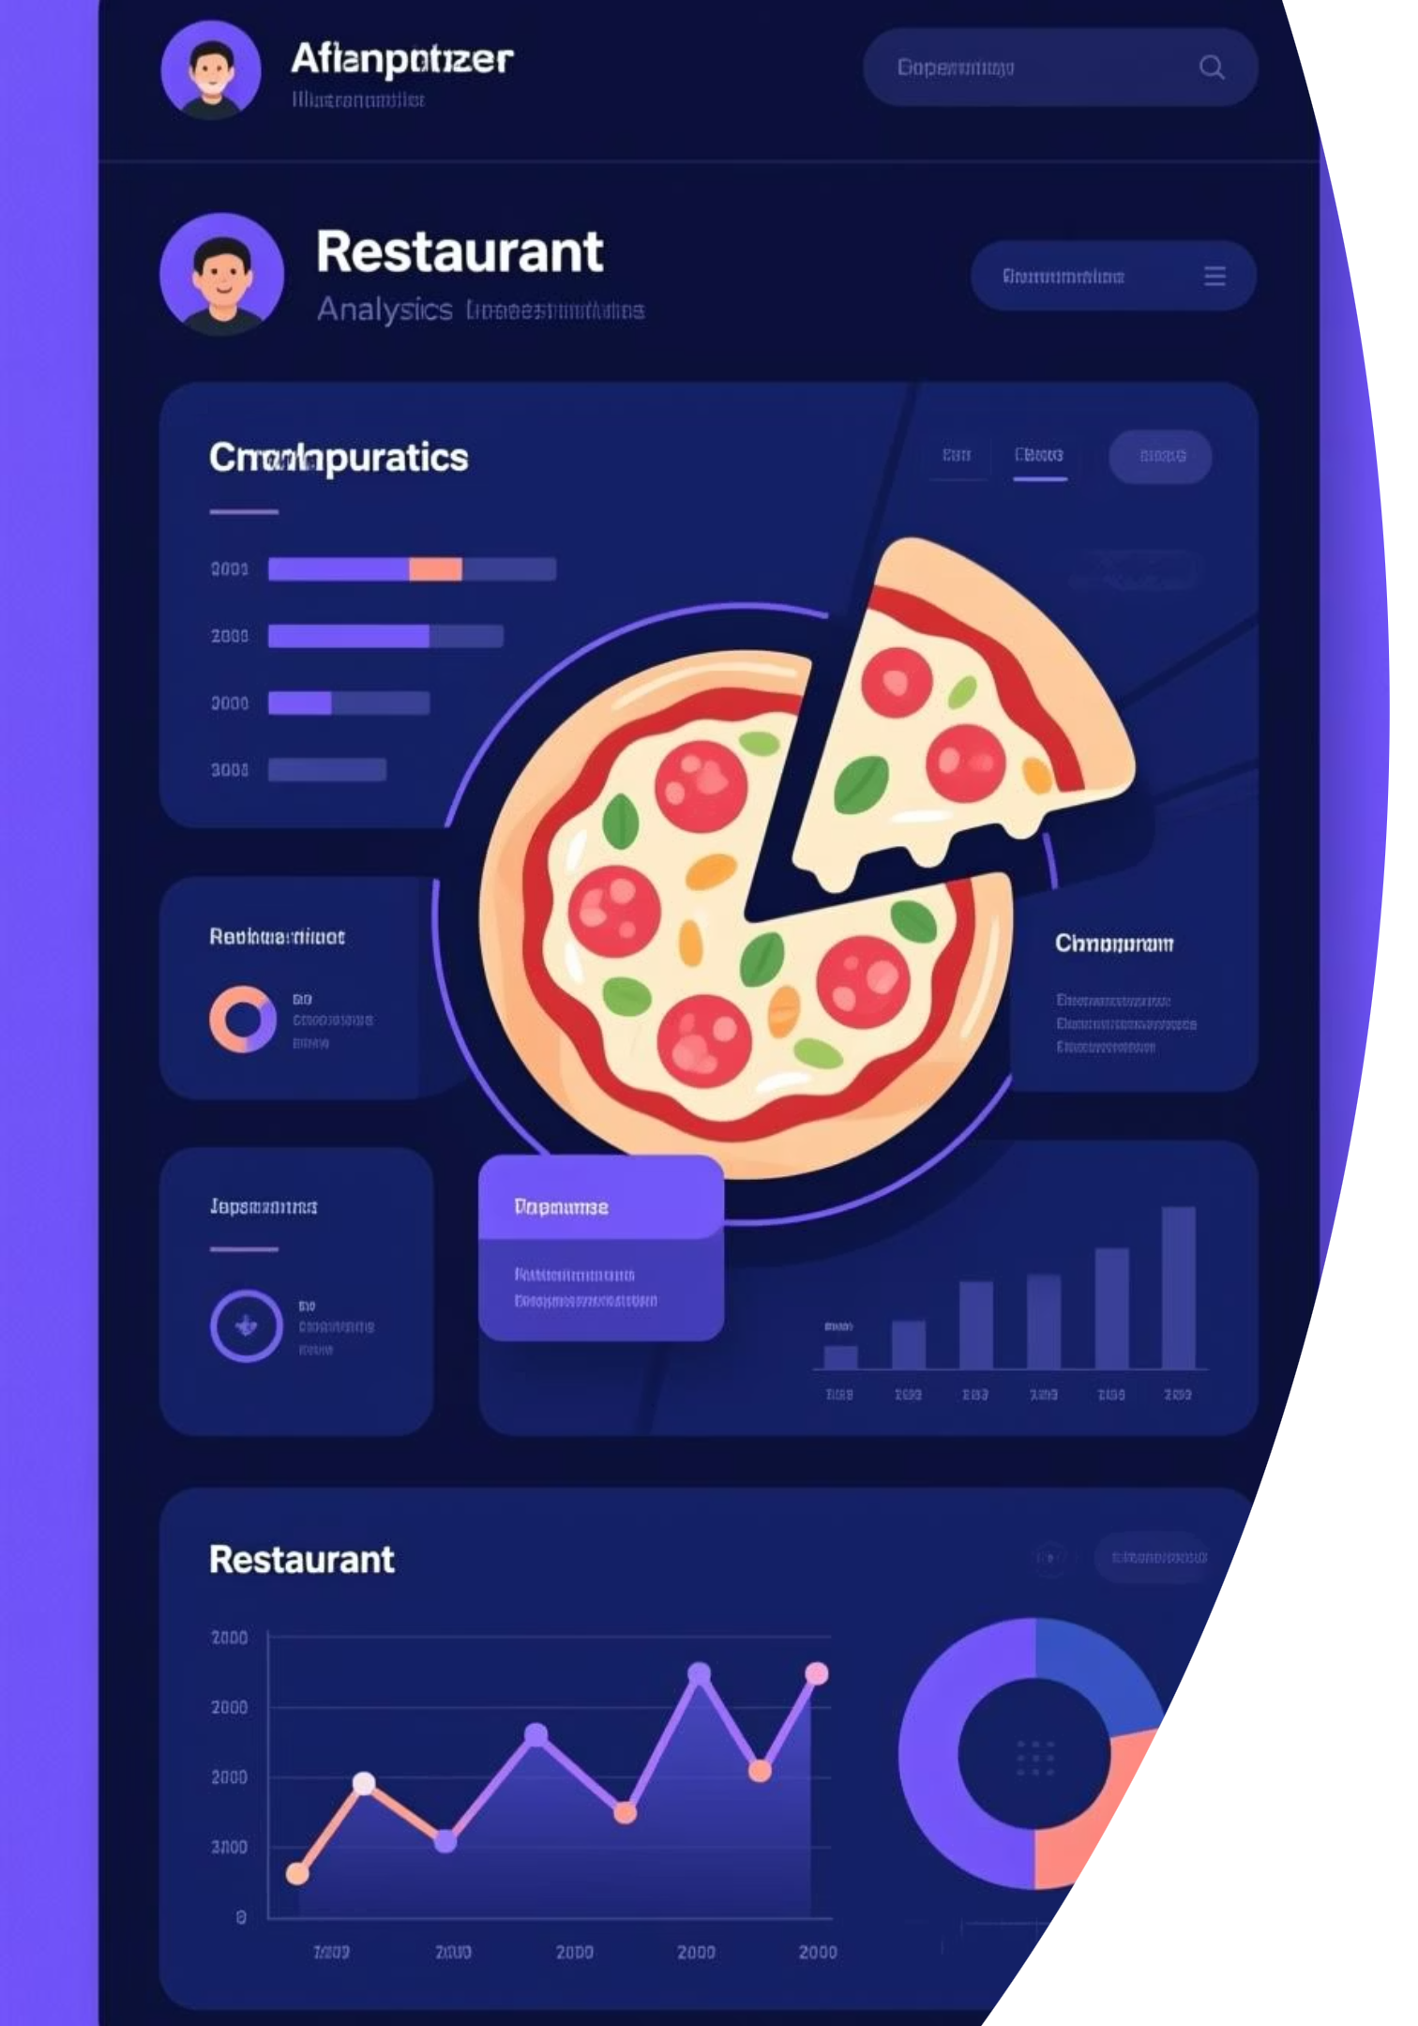
The Great Pizza Analytics Challenge
Transforming IDC Pizza's raw sales data into actionable business insights using SQL
- Pratik Mendon

Slide 2




Project Overview
Explore Database
Apply SQL Techniques
Navigate IDC Pizza's relational database structure and understand table relationships
Use filtering, aggregation, joins, and advanced queries to extract insights
Derive Insights
Transform raw sales data into business intelligence for strategic decision-making

Slide 3
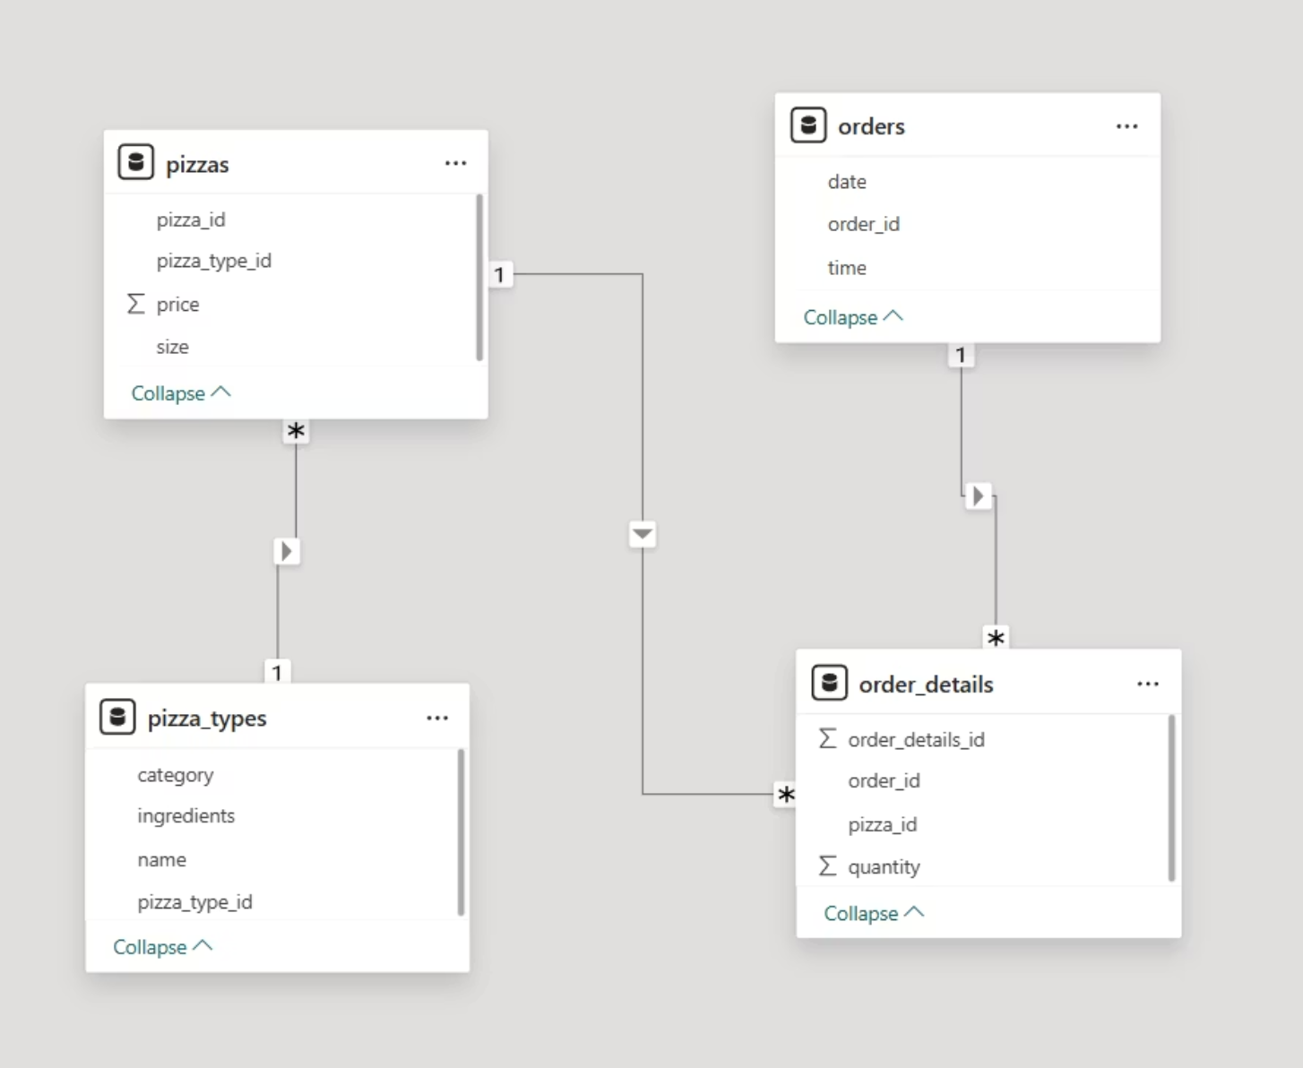
Dataset Overview
IDC Pizza's relational database consists of four interconnected tables that capture the complete order and product ecosystem:
1
orders
order_id, date, time
2
order_details
order_id, pizza_id, quantity
3
pizzas
pizza_id, pizza_type_id, size, price
4
pizza_types
pizza_type_id, name, category, ingredients

Slide 4






Skills Demonstrated
Throughout this 15-day SQL challenge, we applied a comprehensive range of database querying techniques:
Core Queries
Aggregations
SELECT, WHERE, DISTINCT, LIMIT, OFFSET for data retrieval and filtering
SUM, AVG, COUNT, MIN, MAX with GROUP BY and HAVING clauses
Table Joins
Data Manipulation
INNER, LEFT, RIGHT, FULL joins to combine related datasets
String functions, date operations, NULL handling with COALESCE
Conditional Logic
Pattern Matching
CASE WHEN statements for dynamic categorization and calculations
Advanced filtering techniques and text pattern recognition

Slide 5

Phase 1: Foundation & Inspection
01
Database Installation
Set up IDC_Pizza database and verify table structures
02
Categorical Analysis
List unique pizza categories and understand product segmentation
03
Data Quality Checks
Identify NULL ingredients and pizzas missing price information
04
Initial Data Review
Display and examine first rows with cleaned, standardized data

Slide 6
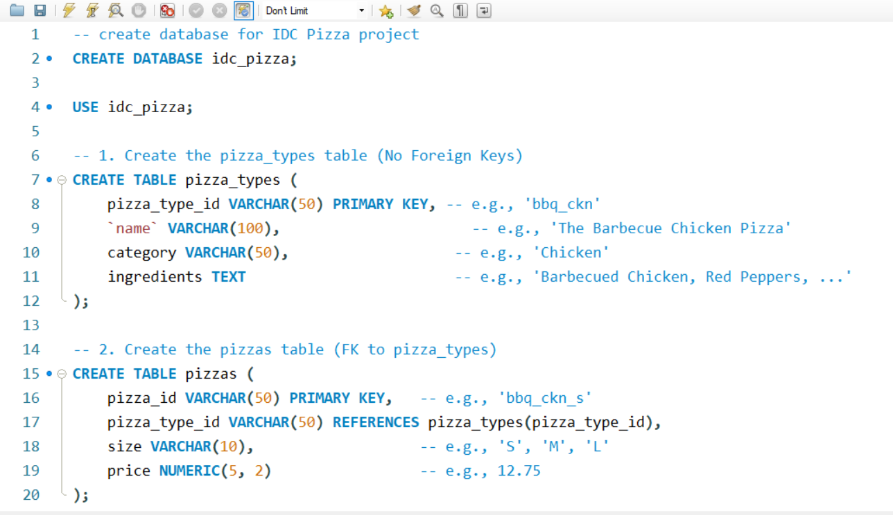
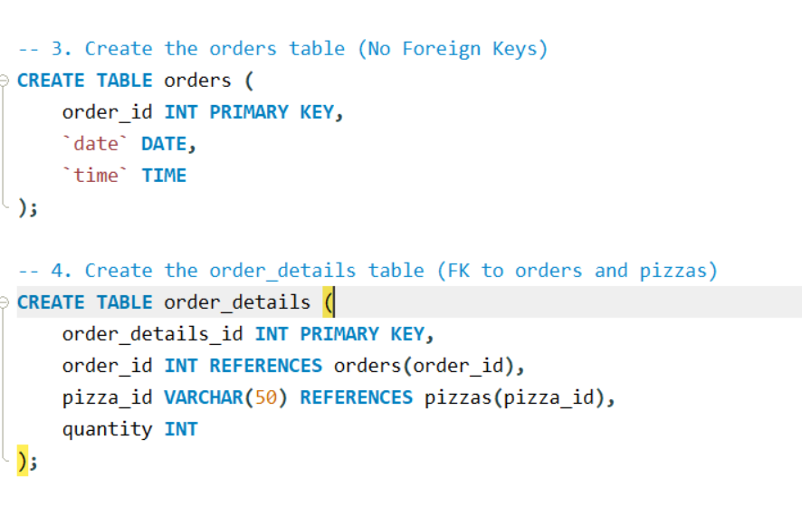
1. Database Installation

Slide 7
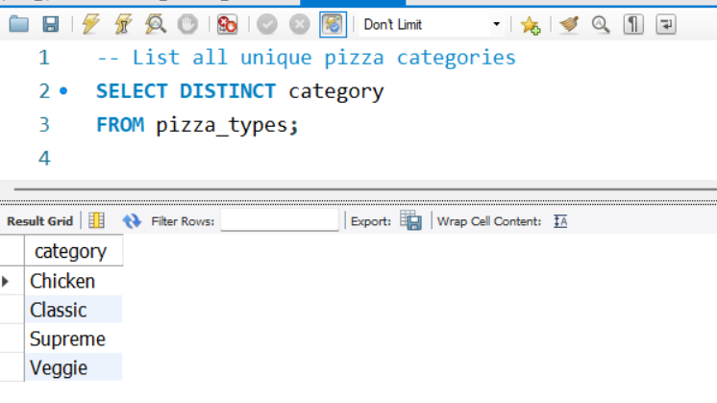
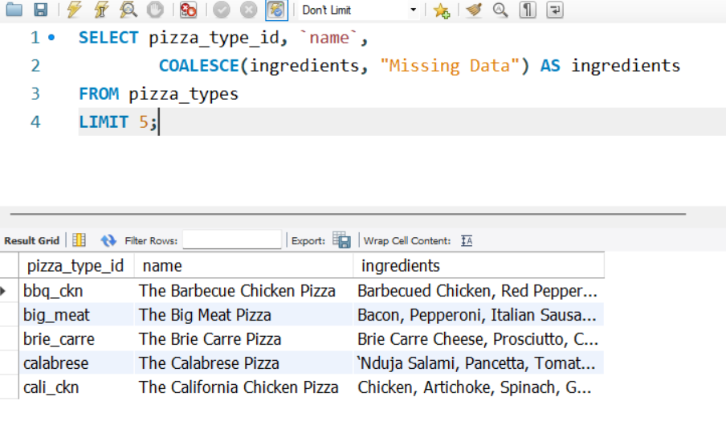
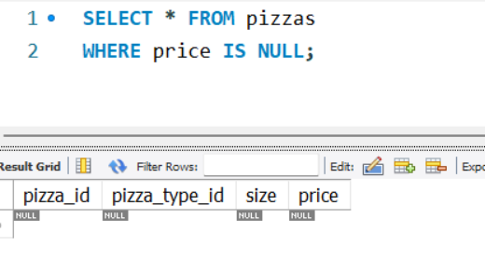
2. List all unique pizza categories
3. Display pizza_type_id,
name, and ingredients, replacing NULL ingredients with "Missing Data". Show first 5 rows.
4. Check for pizzas missing a price >

Slide 8


Phase 2: Filtering & Exploration
Applied advanced filtering techniques to slice and dice the pizza sales data:
Date-Based Filtering
Extract orders from specific dates to analyze daily patterns
Size & Price Ranges
Filter pizzas by size (L, XL) and price brackets for targeted analysis
Keyword Searches
Identify pizzas containing specific ingredients like "Chicken"
Custom Sorting
Order results by price, quantity, or other metrics for insight generation

Slide 9
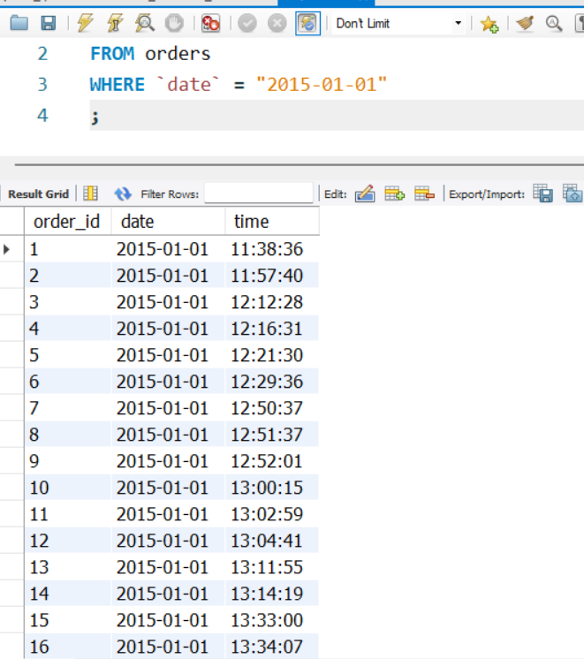
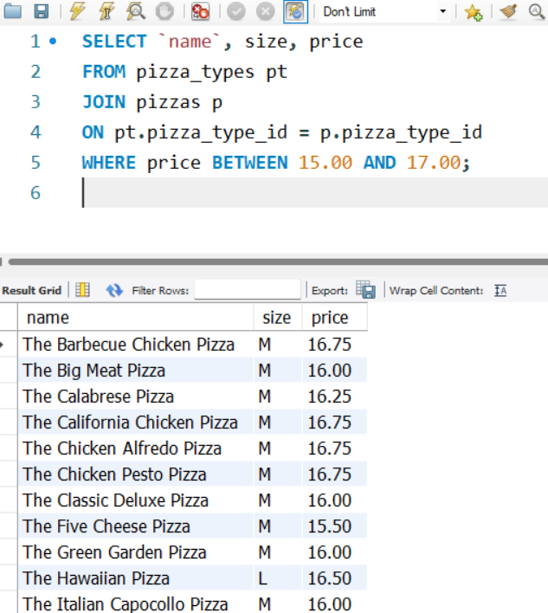
5. Orders placed on '2015-01-01'
6. Pizzas priced between $15.00 and $17.00

Slide 10
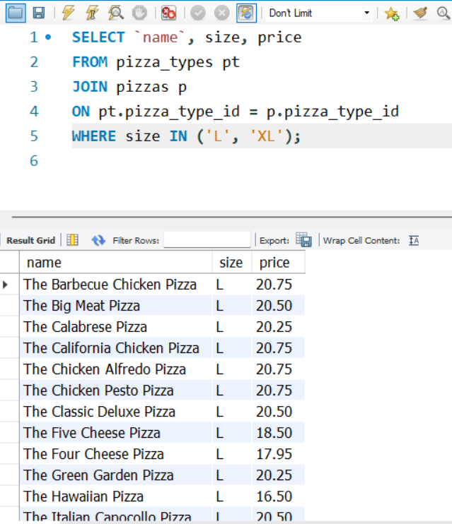
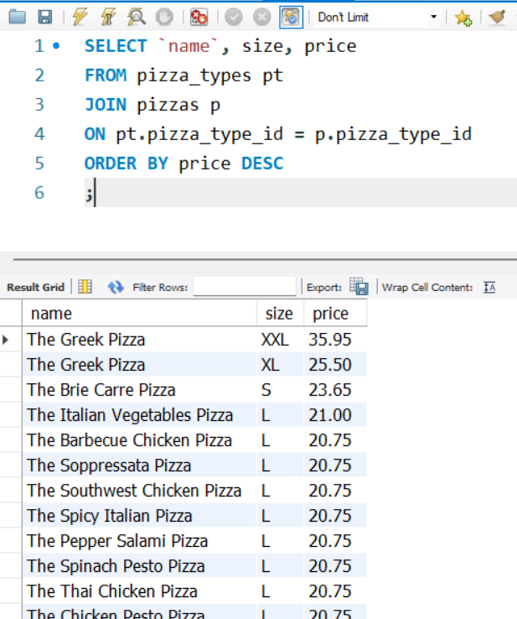
7. Pizzas sold in ‘L’ or ‘XL
8. List pizzas with price descending

Slide 11
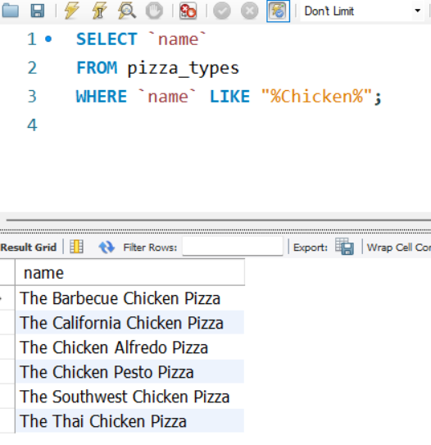
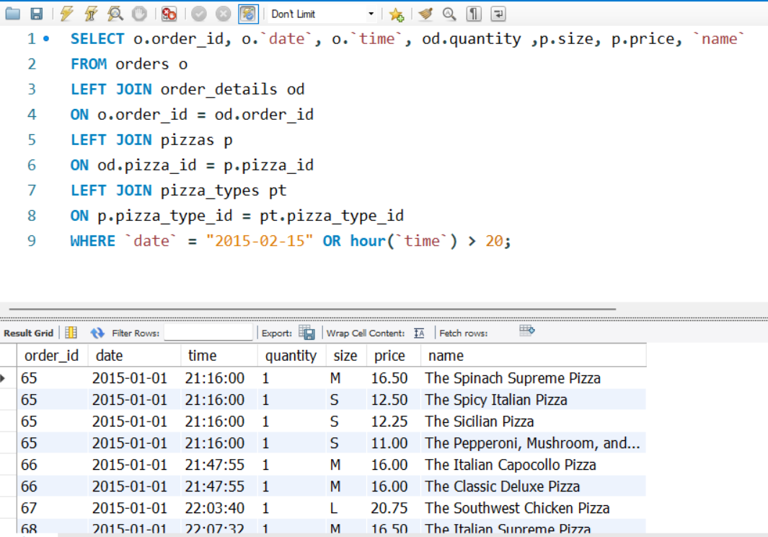
9. Pizzas with “Chicken” in name
10. Orders on '2015-02-15'or placed after 8 PM.

Slide 12
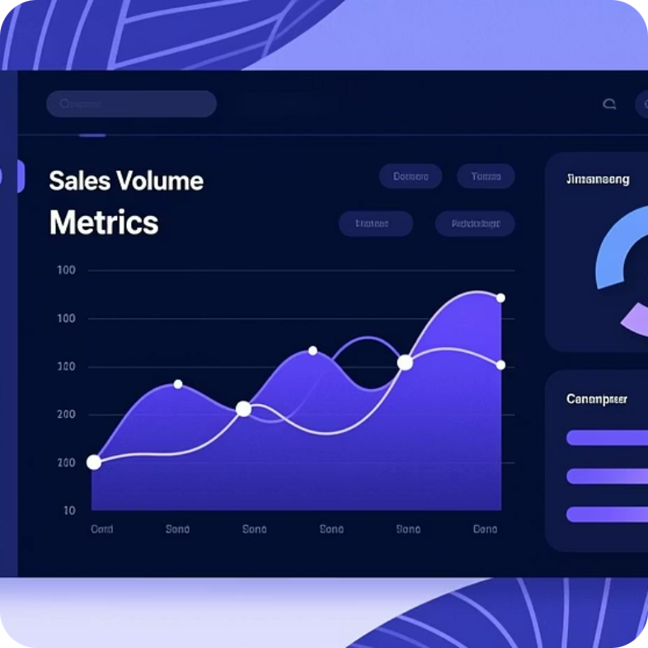
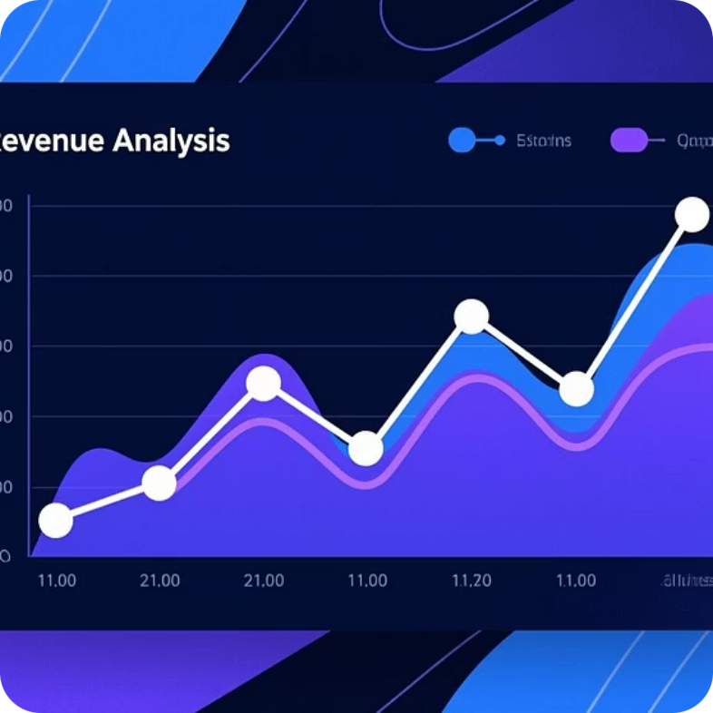
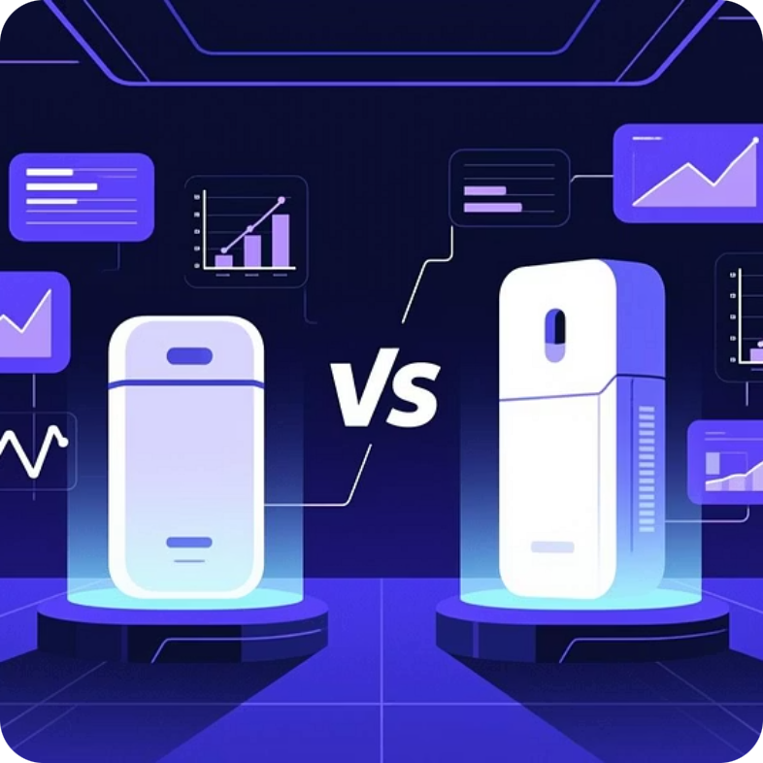
Phase 3: Sales Performance Analysis
Volume Metrics
Revenue Analysis
Product Performance
Total pizzas sold and average price calculations across all orders
Order-level value computation and category performance tracking
Identify top performers, zero-sale items, and pricing differences by size

Slide 13
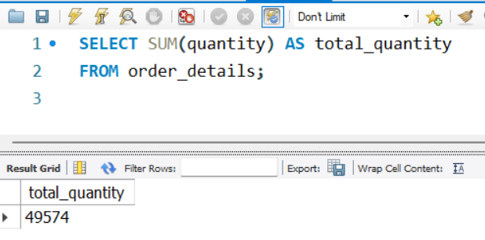
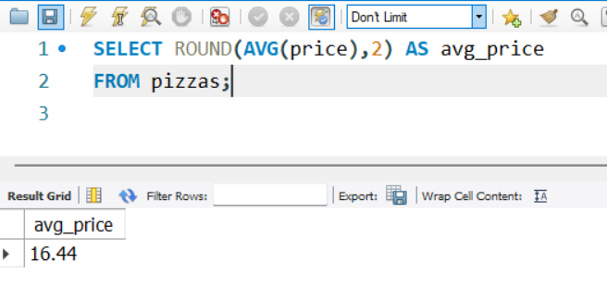
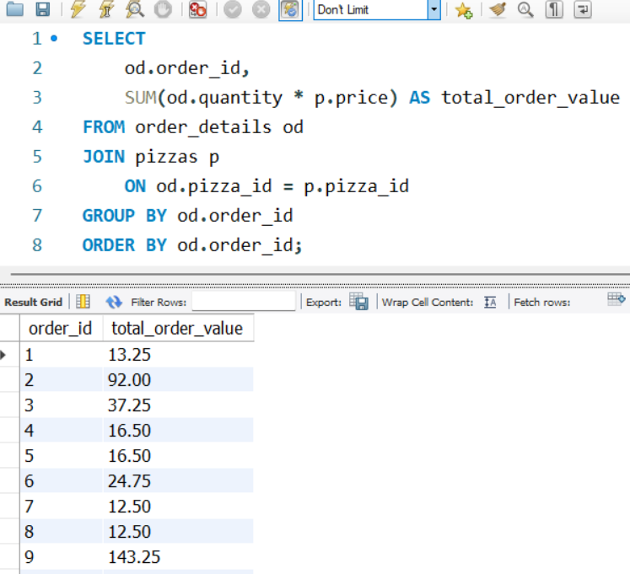
11. Total Quantity of Pizzas sold
12. Average Pizza Price
13. Total Order value per order >

Slide 14
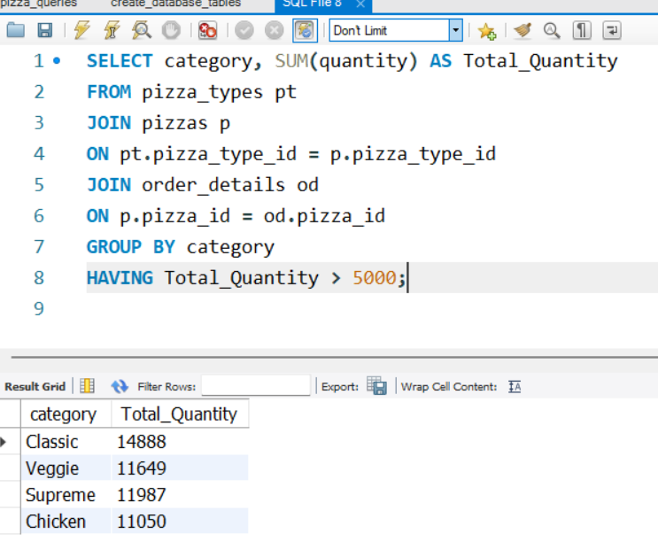
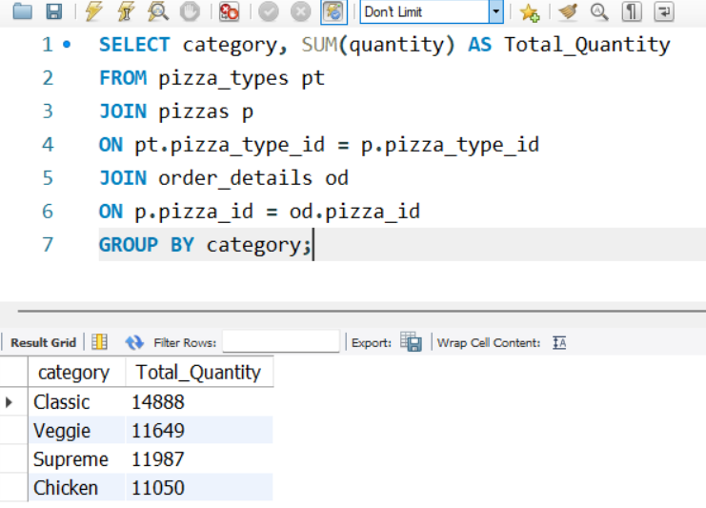
14. Total Quantity sold per category
15. Categories with more than 5000 pizza sold

Slide 15
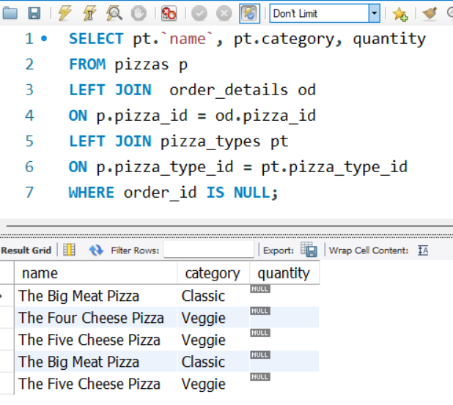
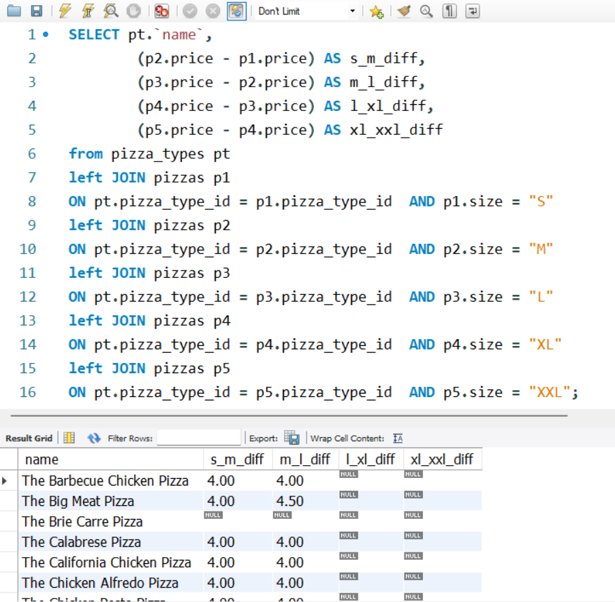
16. Pizzas never ordered
17. Price differences between different sizes of the same pizza

Slide 16
Key SQL Queries Solved
Category Sales Calculation
1
Aggregate total quantity sold and revenue by pizza category using GROUP BY
Top-Performing Pizzas
2
Rank pizzas by revenue and quantity using ORDER BY and aggregation functions
Zero-Sale Products
3
Identify pizzas never ordered using LEFT JOIN and NULL filtering techniques
Order-Level Revenue
4
Calculate total value per order by joining tables and multiplying price × quantity
Size Price Comparison
5
Use self-joins and CASE statements to compare pricing across pizza sizes

Slide 17

Insights & Findings
49,574
5
$35.95
Total Pizzas Sold
Zero-Sale Products
Highest Price
Greek Pizza (Large) commanded premium pricing
Across all orders and categories during analysis period
Pizzas never ordered—candidates for promotion or removal
Peak Hours
Strong Performers
Category Success
Evening sales surge beyond 8 PM requires optimized staffing
Classic pizzas consistently drive high sales volume
All categories exceeded 5,000 units sold threshold

Slide 18
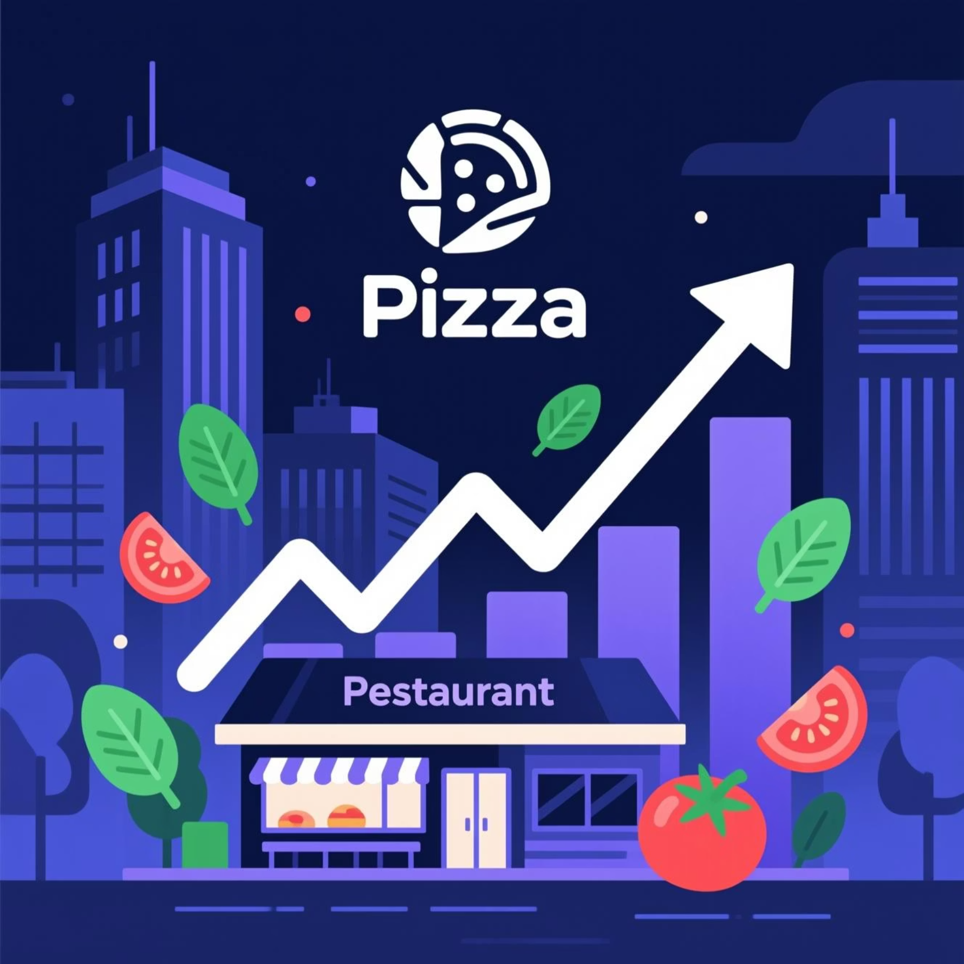

Business Impact & Next Steps
Key Takeaways for IDC Pizza
Menu Optimization
Remove or rebrand the 5 zero-sale pizzas to streamline offerings
Pricing Strategy
Leverage size comparison insights to maximize profit margins
Operational Efficiency
Align kitchen staffing with evening rush patterns
Inventory Management
Ensure stock levels match category sales performance data
Project Success: Demonstrated end-to-end SQL mastery while delivering actionable insights that drive real business value for IDC Pizza.

